Slide 1


IS457
Mobile Applications
Lecture 3
Mobile Programming- Android Studio

Slide 2
Activity Destructions
Normal
When user presses back button.
When code calls finish().
Abnormal
An activity unused for a while can be destroyed by system without warning!!.
User rotates screen!

Slide 3
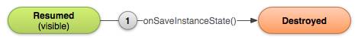
Recreating Activity
By default, the system uses the Bundle instance state and a combined approach onSaveInstanceState() to save information about each View object in your activity layout (such as the text value entered into an EditText widget) .
So, if your activity instance is destroyed and recreated, the state of the layout is restored to its previous state with no code required by you.

Slide 4
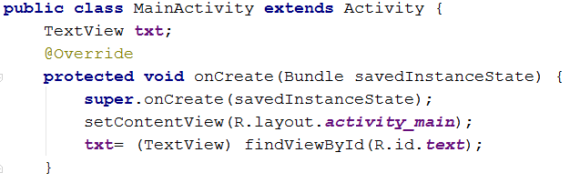
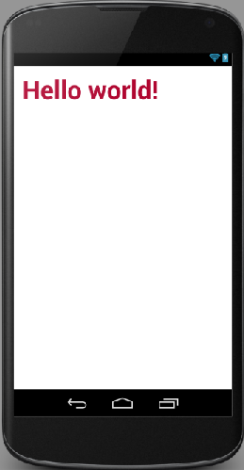
Android Activity “Hello World!” Example

Slide 5
Activity UI
If an app is to be interactive it needs a View.
Views include widgets.
Views can be grouped using ViewGroups.
Derive from Android.view.view

Slide 6
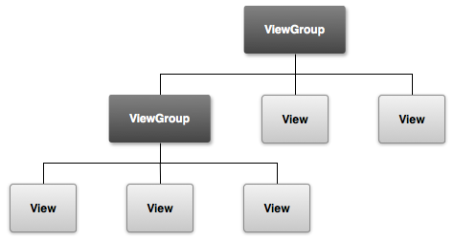
Activity UI
Many type of:
Widgets (Views): Buttons, TextView, ImageView, ProgressBar…etc.
ViewGroups: LinearLayout, ConstraintLayout, TableLayout, RelativeLayout, FrameLayout.

Slide 7
Views & ViewGroups Attributes
Most are start with word
Giving id
android:id = unique identifier.
Must start with @ followed by type (in this case id)
+ needed when defining resource. Not needed for concrete resources such as strings.
Android:
<Button
android:layout_width="match_parent"
android:layout_height="wrap_content"
android:text="Next"
android:textSize="30dp"
android:id="@+id/button"
/>

Slide 8
Views & ViewGroups Attributes
LayoutParams
class just describes how big the view or viewgroup wants to be for both width and height. It can be specify either by numbers OR by constants
Fill_parent | uses maximum available width. android:layout_width= “fill_parent“
Wrap_content | height restricted by component (usually text)height. android:layout_width= “wrap_content“
Match_parent | Same as Fill_parent in API Level 8 and higher android:layout_width= “match_parent“

Slide 9
Views & ViewGroups Attributes
Measurements Units
  dp = Density-independent pixel. 160dp = 1 screen inch. (Recommended)
  Sp = Scale –independent pixel (recommended for font sizes). The SP unit is sensitive to the user’s display setting, so it makes text flexible for all screen sizes.
android:layout_marginBottom="427dp"
android:textSize="34sp"

Slide 10
Views & ViewGroups Attributes
Measurements Units
mm | Millimeters - based on the physical size of the screen.
px | Pixels - corresponds to actual pixels on the screen.
pt | Points - 1/72 of an inch based on the physical size of the screen
in | Inches - based on the physical size of the screen. 1 Inch = 2.54 centimeters

Slide 11
Views & ViewGroups Attributes
Colors
  Programmatically (Java file)
  Names: Color.RED, Color.BLUE….etc.
  OR Color.parseColor("#44f0a0")
  In XML file
txt.setTextColor(Color.RED);
txt.setTextColor(Color.parseColor("#44f0a0"));
android:textColor="#ffb360"

Slide 12
Views & ViewGroups Attributes
Many more attributes…..
Can we change the text size programmatically (Java file)?
How do you deal with layouts (viewgroups) programmatically?
android:textStyle="bold"
android:gravity="center"

